Slide 1
FET ARRAY DESIGN-STICK DIAGRAMS
BY
SRITEJA TARIGOPULA
SUBMITTED TO
DR.ROMAN STEMPROK
MSET5810.001

Slide 2
FET Array Design – Stick Diagrams
Basics/History

Slide 3
FET Array Design – Stick Diagrams
One approach to design complex gate layouts is to use Stick Diagrams.
  Each layer is represented by a distinct color.
  The width of the line is not important as the stick diagrams give only the wiring and routing information.
  Useful for planning the routing and layout of integrated circuits.

Slide 4
FET Array Design – Stick Diagrams
Commonly used stick diagrams colors are :
  Polysilicon (gates) = red
  Doped n+ / p+ (active) = green
  N-well either by ----- (dashed line) or yellow
  Metal1 = blue
  Metal 2= gray
  Contacts = Black X

Slide 5
FET Array Design – Stick Diagrams
Simple set of rules providing the basics of stick diagrams are:
  A red line crossing a green line creates a transistor
  Red over green enclosed by dashed lines or red over green inside a yellow border region gives a pFET; otherwise a nFET
  Red may cross blue or gray
  Blue may cross red, green, or gray
  Gray may cross red, green, or blue
  Transistor contacts must be placed from blue to green
  Vias must be specified to contact blue to gray
  A (poly) contact must be used to connect blue to red

Slide 6
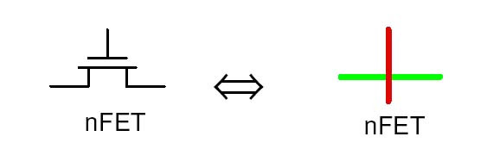
FET Array Design – Stick Diagrams
An nFET is formed whenever a Red(poly) crosses over Green (active)

Slide 7
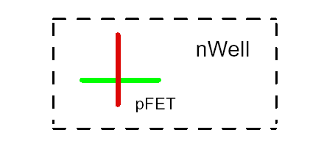
FET Array Design – Stick Diagrams
A pFET is described by the same “red over green coding”, but the crossing point is contained in a nWell boundary

Slide 8
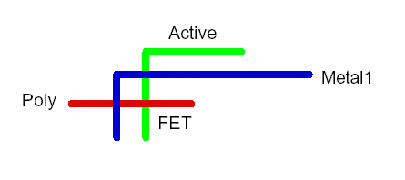
FET Array Design – Stick Diagrams
Blue (Metal) may cross over Green (active) or Red (poly) without any connection

Slide 9
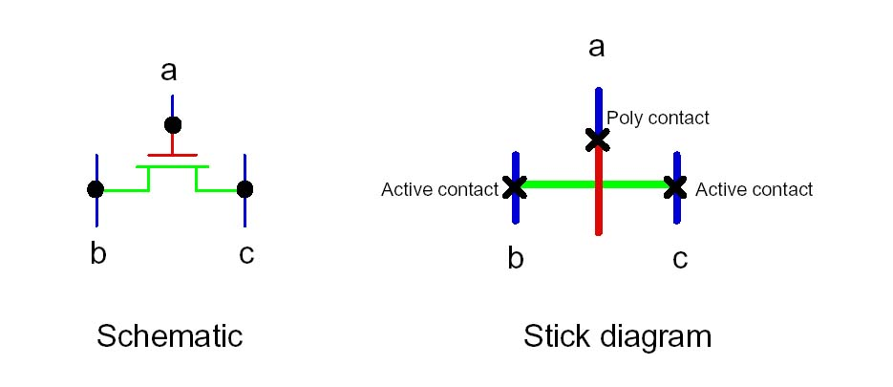
FET Array Design – Stick Diagrams
Connections between layers are specified as X. Consider the Example of nFET. In this layout,
  Poly contact: Metal1-to-Poly
  Active contact: Metal1-to-Active

Slide 10
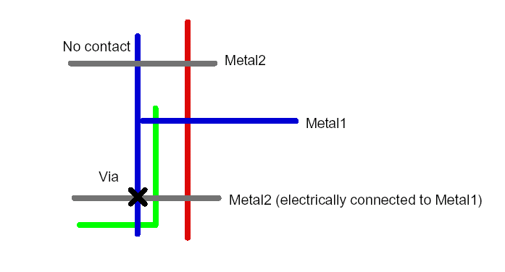
FET Array Design – Stick Diagrams
Metal lines on different layers can cross one another. Contacting two metal lines requires a via

Slide 11
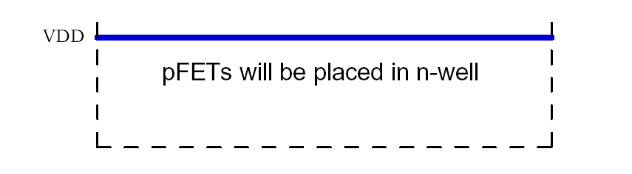
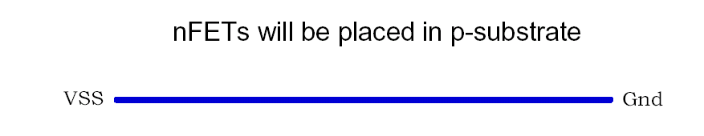
To create CMOS gates
To Create CMOS gates,
VDD is represented as,
  VSS is represented as,

Slide 12
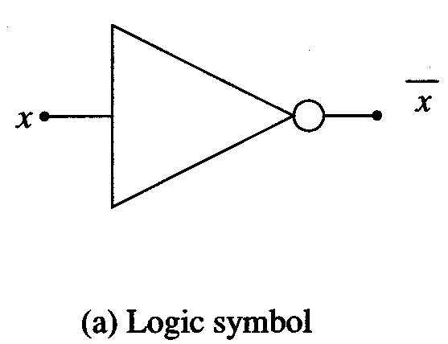
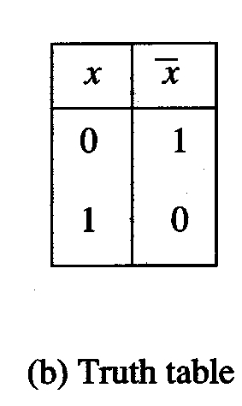
FET Array Design – Stick Diagrams
Consider the example of a NOT gate as shown below

Slide 13
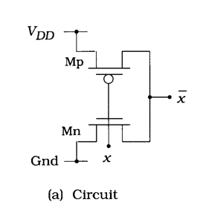
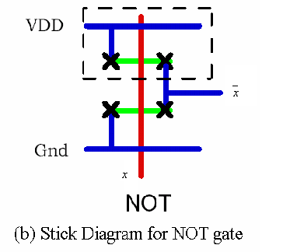
FET Array Design – Stick Diagrams
Inverter layout is given as shown below,

Slide 14
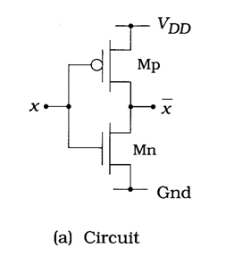
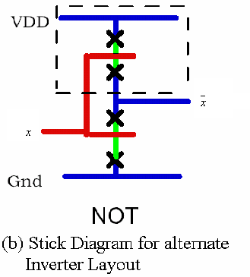
FET Array Design – Stick Diagram
Alternate Inverter Layout,

Slide 15
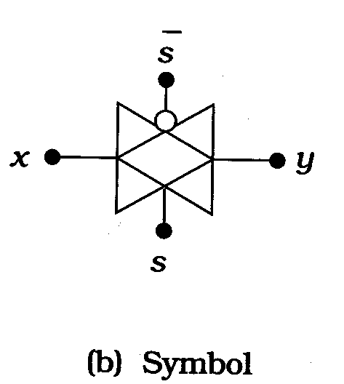
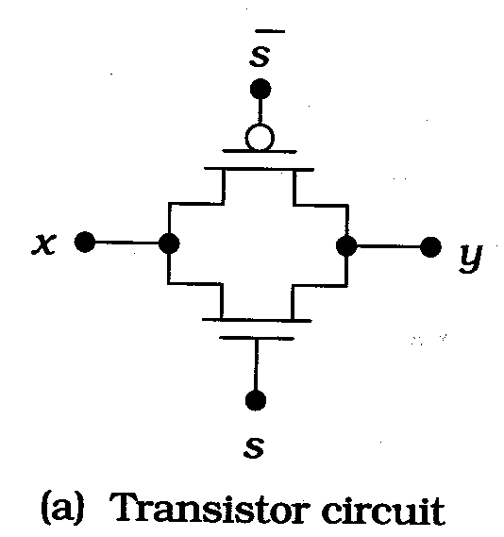
FET Array Design – Stick Diagrams
Transmission Gates. The symbol and circuit of a transmission gate is as shown below.

Slide 16
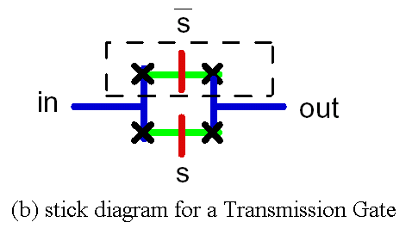
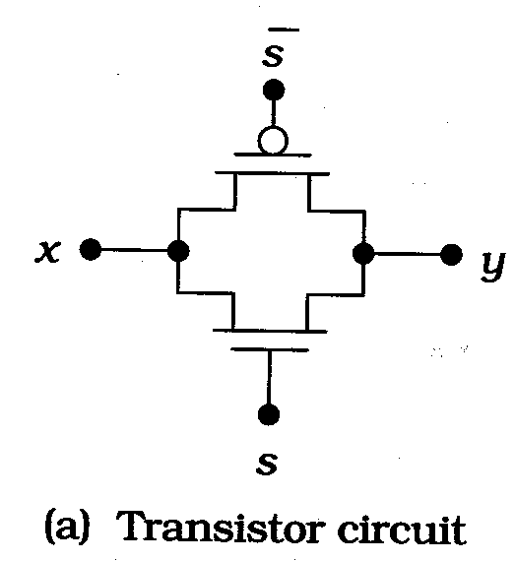
FET Array Design – Stick Diagrams
The stick diagram layout for a transmission gate is as shown below.

Slide 17
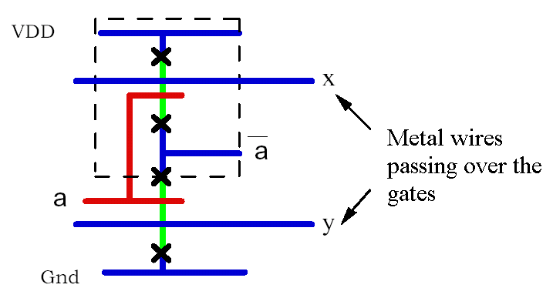
FET Array Design – Stick Diagram Layout
Stick diagrams are often used to solve routing problems

Slide 18
FET Array Design – Stick Diagrams
Uses:
  Provides easy approach to performing simple CMOS circuit layouts
  Helps in planning physical design before using the actual CAD tool
  Complicated wiring of gates and cells is often easier to visualize using stick diagrams
  Crossovers (such as Metal1-Metal2) are easy to plan using stick diagrams
  Helps in visualizing the signal flow in complex networks

Slide 19
FET Array Design – Stick Diagrams
References:
  Introduction to VLSI Circuits and Systems, by John P.Uyemura
  Physical Design of CMOS Integrated Circuits, by John P.Uyemura
  Basic VLSI Design – Principles and Applications, by D.A.Pucknell and K.Eshraghain
  http://www.personal.dundee.ac.uk/~dmgoldie/teaching/eg4013/lectures/10
  http://www.microlab.ch/academics/courses/cbt/cbt-vlsi/layers_repres.html
  http://www.stanford.edu/class/ee271/stick_to_layout/stick_to_layout.html

Slide 20
Thank you…

